Slide 1
Machine Learning approach to study leading causes of deaths in United States
Ramesh Sharma
Data Science Carrer Track
Springboard

Slide 2
Dataset(s)
Dataset from ‘Centers for Disease control and and Prevention (CDC)’ is used to investigate the leading causes of deaths in United States between 1997 and 2017.

Slide 3
Motivation
Study and analysis of Mortality and its causes is critical for the interpretation of national trends and international comparisons. Mortality statistics are a mirror to the situation of health prevalent in a population. The mortality trends depict the picture of population’s health status.In depth analysis of deaths and its indicators can substantiate the progress of health programs.

Slide 4
Research Question(s)
What is the total number of records in the dataset?
What were the causes of death in this data set?
What is the number of deaths per each year from 1999 to 2017?
What were the top causes of deaths in the United States during this period?
See how machine learning algorithms works on this data set.

Slide 5
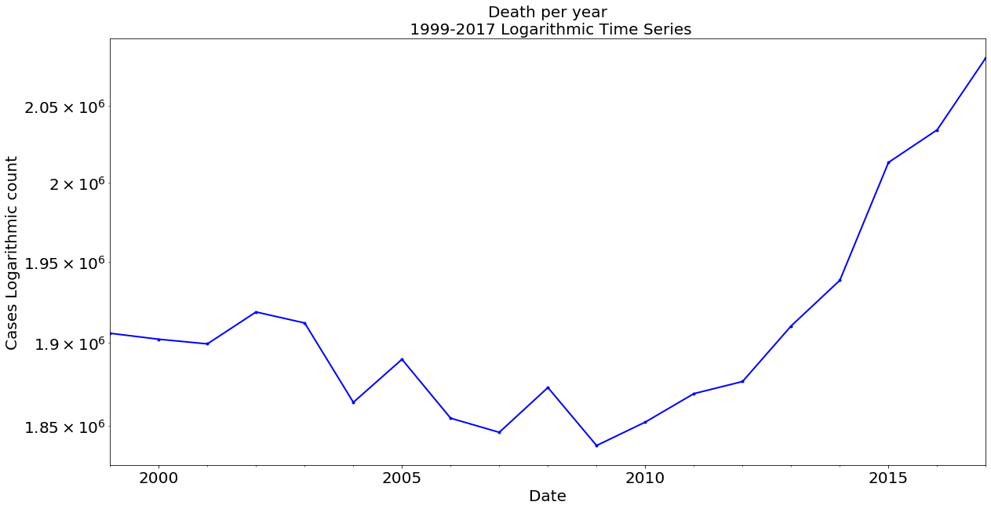
Deaths over the year from 1999-2017
The number of deaths declined between 2002 and 2009. Then there was a continuous growth in the number of deaths from 2010 to 2013. Finally, there was a sharp increase in the number of deaths in 2013 and 2014.

Slide 6
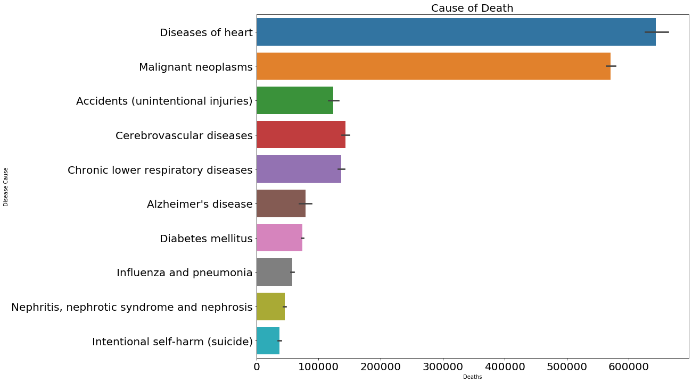
Top causes of Deaths
Line graph shows tha top causes responsible for deaths in United States
Number of deaths are increasing, and the major contributing causes belongs to non-communicable disease like heart disease and cancer.

Slide 7
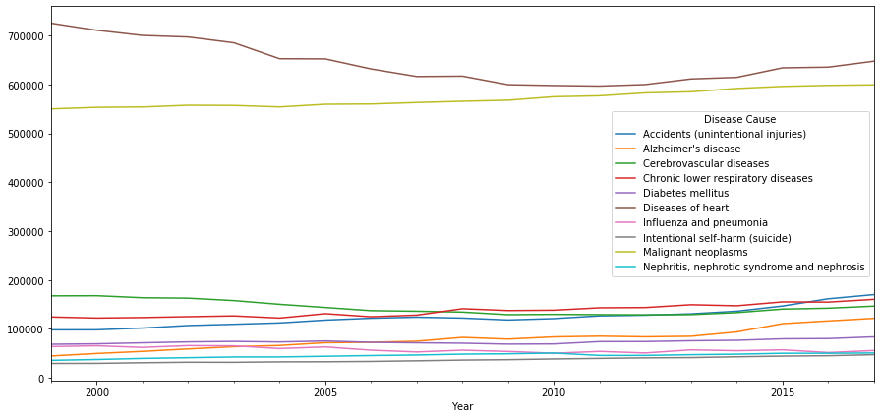
Causes of deaths over the year 1999 to 2017
Unique cases responsible for number of deaths over a period of year 1999- 2017
Accidents (unintentional injuries)', "Alzheimer's disease", 'Cerebrovascular diseases', 'Chronic lower respiratory diseases', 'Diabetes mellitus', 'Diseases of heart', 'Influenza and pneumonia', 'Intentional self-harm (suicide)', 'Malignant neoplasms', 'Nephritis, nephrotic syndrome and nephrosis'.

Slide 8
Statistical Analysis
The purpose of statistical analysis of our dataset is to explore some of the basic concepts of statistics using capstone project one dataset. We started using basic python codes to explore the descriptive statistics of dataset. Dataset has 10868 observations in all columns. Same number of observations also implies that there is no missing values in our dataset.

Slide 9
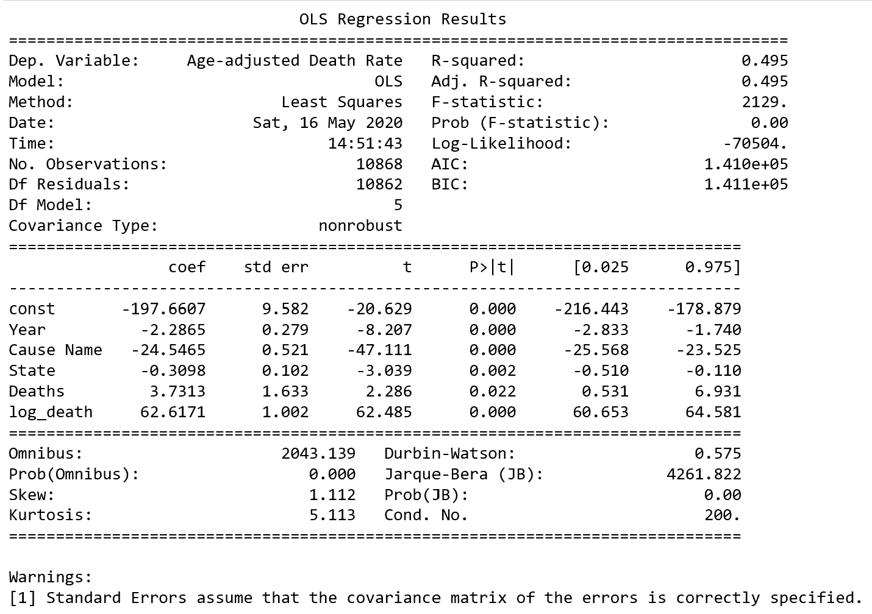
Statistical Analysis
Ordinary Least- Squares (OLS) Regression technique is used for statistical learning of the dataset using the statsmodel python package.
OLS uses squared error which has nice mathematical properties thereby making it easier to differentiate and compute gradient descent.

Slide 10
Workflow for Machine Learning
Data
Obtain Dataset For Leading Causes of Deaths from CDC
Pre-Process the data
Transform the Input Data
Multiple Linear Regression
Random Forest Regression
Xg Boost Regression
Metric : Accuracy
Select the best model for Hypertuning the parameters
Metric : RMSE

Slide 11
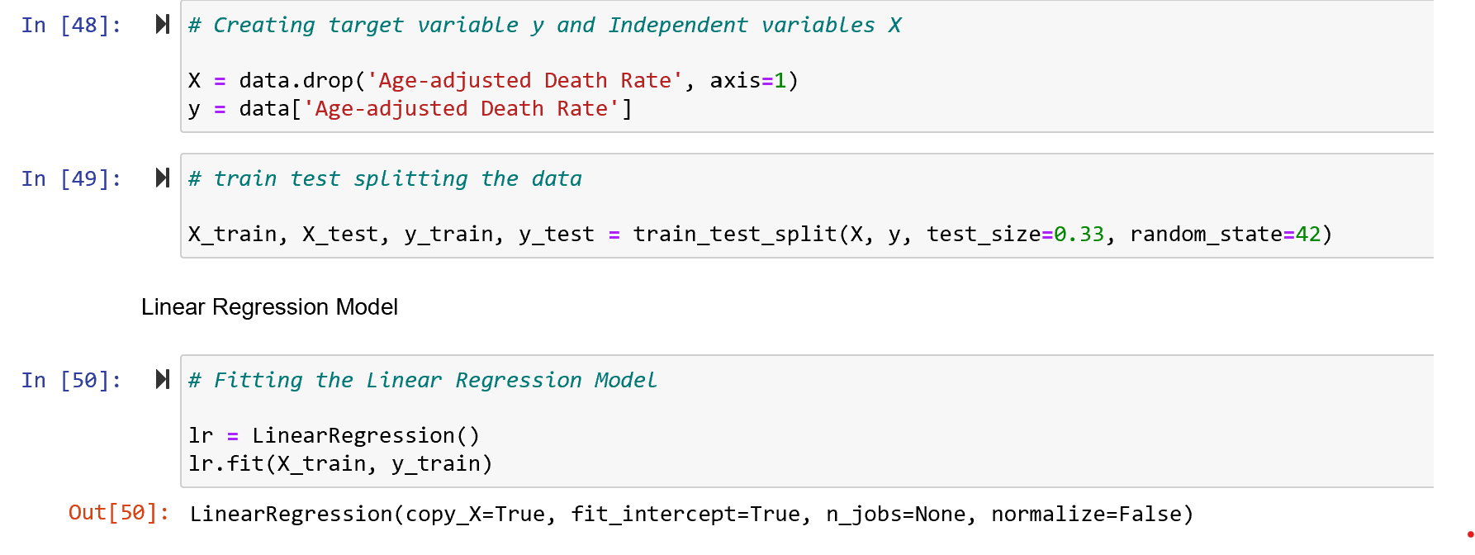
Multiple Linear Regression

Slide 12
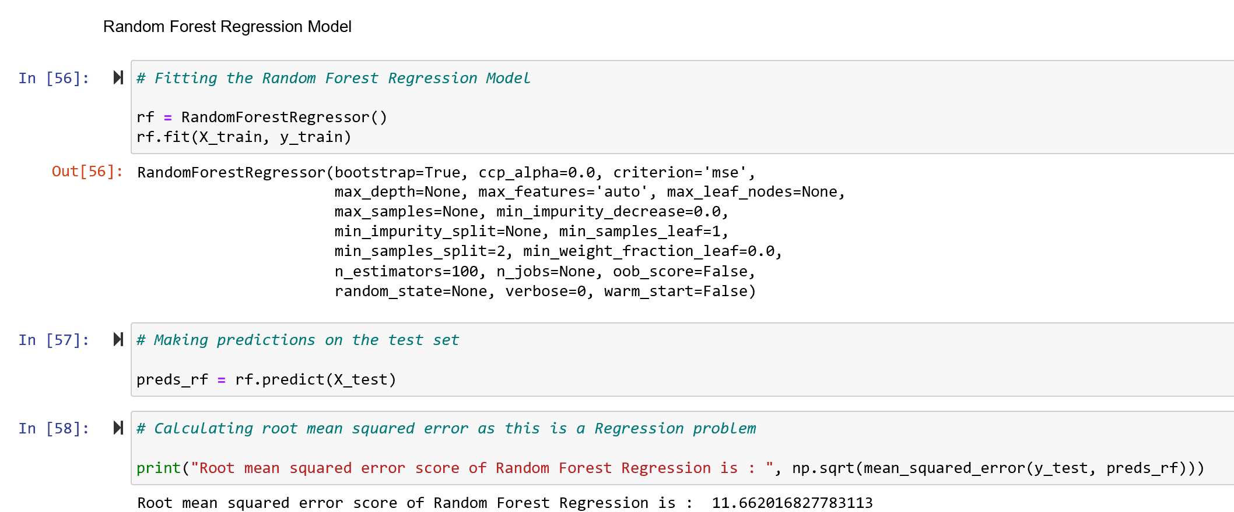
Random Forest Regression

Slide 13
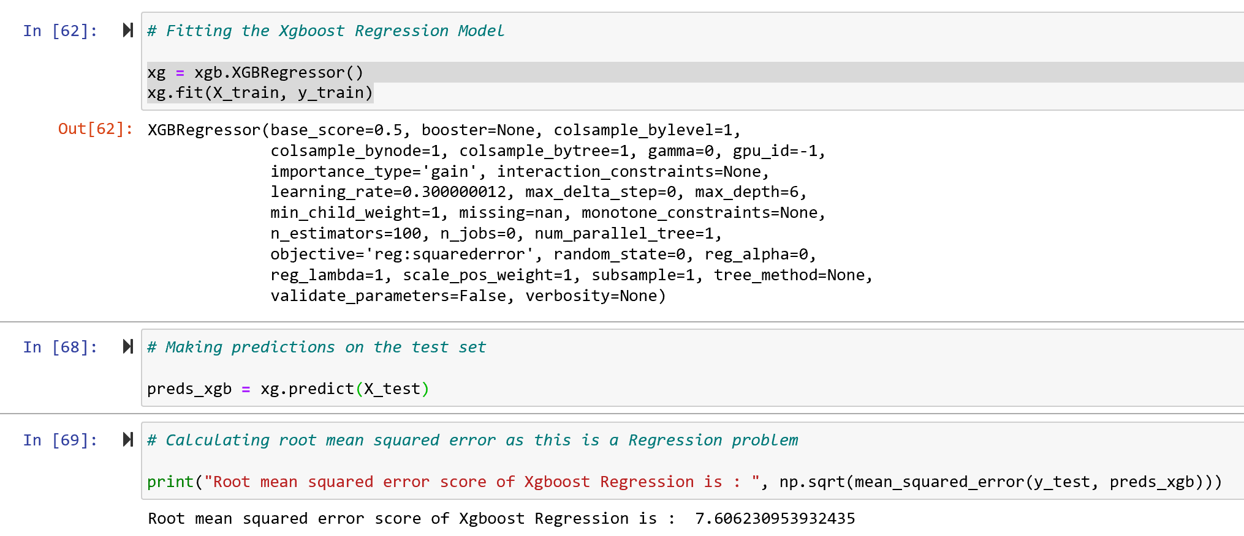
Xgboost Regression

Slide 14
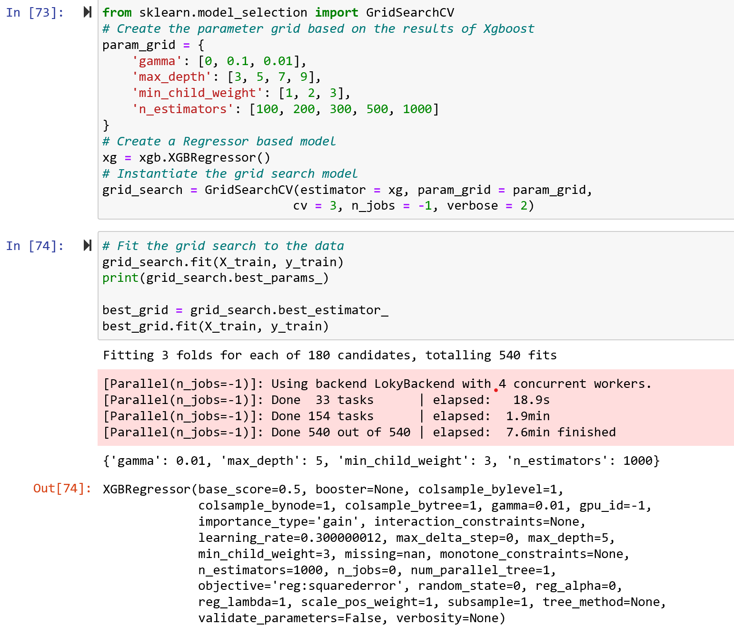
Hypertuning model

Slide 15
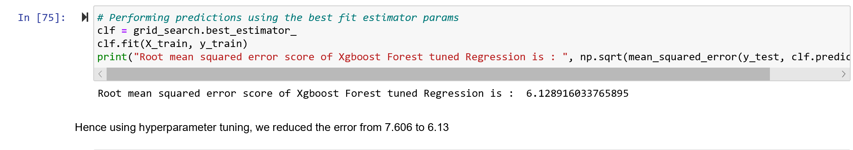
Hypertuning model

Slide 16
Conclusions
A comparison of the performance of each model showed the root mean square error to be lowest for the Xgboost method, at 6.17, which translates to a 99.9% successful predictive rate in terms of classifying age adjusted death rate.
This study demonstrates the feasibility of machine learning in the predicting age adjusted mortality rate on different states based on leading causes of disease.
The results obtained can contribute to the prevention of leading cause of deaths by raising awareness of potential risks, by quantitatively predicting age adjusted fatality and incorporating the findings with healthcare industry.

Slide 17
Acknowledgements
I would like to thank mentors from this course Python for Data Science. Coming from completely different background, mentors slides and notebook has helped me do this analysis.

Slide 18
References
https://ibis.health.state.nm.us/resource/AARate.html
https://www.statsmodels.org/stable/generated/statsmodels.stats.outliers_influence.variance_inflation_factor.html
https://statisticalhorizons.com/multicollinearity
Muller A. Education, income inequality, and mortality: a multiple regression analysis. BMJ. 2002;324(7328):23‐25. doi:10.1136/bmj.324.7328.23
Yu W: Application of support vector machine modeling for prediction of common diseases: the case of diabetes and pre-diabetes. BMC Medical Informatics and Decision Making. 2010, 10 (1): 16-10.1186/1472-6947-10-16.
Breiman L: Random forests. Machine learning. 2001, 45 (1): 5-32. 10.1023/A:1010933404324.
Chen, T.; Guestrin, C. XGBoost. In Proceedings of the 22nd ACM SIGKDD International Conference on Knowledge Discovery and Data Mining—KDD ’16, San Francisco, CA, USA, 13–17 August 2016; pp. 785–794

